Slide 1


<Akrem Zaghdoudi>
<11/08/2024>

Slide 2

Outline
Executive Summary
Introduction
Methodology
Results
Conclusion
Appendix

Slide 3

Executive Summary
Summary of methodologies :
Data Collection through API and Web Scraping
Data Wrangling
Exploratory Data Analysis with SQL and Pandas
Exploratory Data Analysis with Data Visualization (Matplotlib)
Interactive Visual Analytics with Folium
Machine Learning Prediction (Classification)
Summary of all results :
Exploratory Data Analysis helped to choose the best features affecting the landing success.
Interactive analytics in screenshots that provided helpful insights.
Predictive Analytics showed the best model to predict .

Slide 4
Introduction
Project background and context
- SpaceX has revolutionized the space industry by significantly reducing launch costs, primarily due to the reusability of the Falcon 9 rocket's first stage. While a typical Falcon 9 launch costs $62 million, competitors' prices can soar to $165 million per launch. The ability to predict whether the Falcon 9's first stage will land successfully is crucial for estimating the overall cost of a launch. This prediction model can also provide valuable insights for other companies, like a hypothetical competitor Space Y, seeking to bid against SpaceX for rocket launches
Problems We want to find answers :
How can we accurately estimate the total cost of a launch ?
Where could be the best location to make those launchs ?
What are the factors that play a significant role in determining whether the Falcon 9 first stage will land successfully ?

Slide 5

Section 1

Slide 6
Methodology
Executive Summary
Data collection methodology:
Data was collected from two sources : Space X API and WebScrapping (Wikipedia)
Perform data wrangling
Collected data was enhanced by creating a landing outcome labelbased on the outcome data, after summarizing and analyzing the relevant features
Perform exploratory data analysis (EDA) using Data visualization and SQL
Perform interactive visual analytics using Folium and Plotly Dash
Perform predictive analysis using classification models
Collected data was normalized and split into training and test datasets, then evaluated with four different classification models, with each model's accuracy .

Slide 7
Data Collection
• The data sets were collected from: :
- The SpaceX API , the data collection was done using get request method .Next, we decoded the response content as a Json using .json() function call and turn it into a pandas dataframe using .json_normalize().
- A permanently linked Wikipedia page with launch data in HTML tables which we performed web scraping from with BeautifulSoup. We extracted the records then parse the table and convert it to a pandas dataframe for future analysis
• We then cleaned the data, checked for missing values and fill in missing values where necessary.

Slide 8
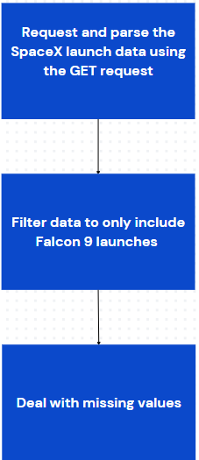
Data Collection – SpaceX API
SpaceX offers a public API from where data can be obtained and then used; (« https://api.spacexdata.com/v4/rockets/ »)
Add the GitHub URL of the completed SpaceX API calls notebook (must include completed code cell and outcome cell), as an external reference and peer-review purpose

Slide 9
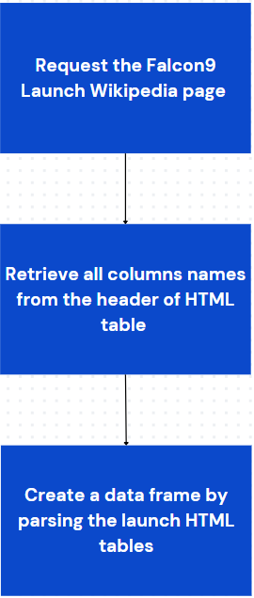
Data Collection - Scraping
Data was scraped from Wikipedia(«https://en.wikipedia.org/w/index.php?title=List_of_Falcon_9_and_Falcon_Heavy_launches&oldid=1027686922»)
Add the GitHub URL of the completed web scraping notebook, as an external reference and peer-review purpose

Slide 10
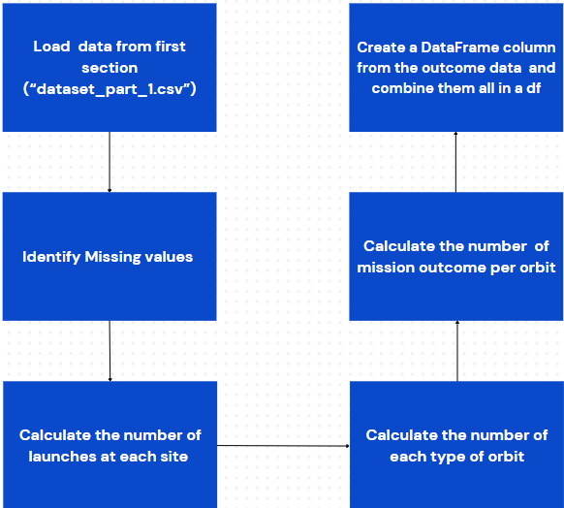
Data Wrangling
We performed EDA to identify patterns in the data , analyze the dataset and establish the appropriate training labels
Add the GitHub URL of your completed data wrangling related notebooks, as an external reference and peer-review purpose

Slide 11
EDA with Data Visualization
Many charts were plotted we used them to analyze :
Launch Site Trends:
- Scatterplot illustrating the relationship between mission outcome, Launch Site, and Flight Number.
- Scatterplot showing the relationship between mission outcome, Launch Site, and Payload.
Orbit Type Trends
- Bar chart depicting the relationship between mission outcome and Orbit Type.
- Scatterplot displaying the relationship between mission outcome, Orbit Type, and Flight Number.
- Scatterplot revealing the relationship between mission outcome, Orbit Type, and Payload.
Temporal Trends
- Line plot demonstrating the trend of mission outcomes over the years.
Add the GitHub URL of your completed EDA with data visualization notebook, as an external reference and peer-review purpose

Slide 12

EDA with SQL
We loaded the Space X dataset into the corresponding table in a Db2 database
We executed SQL queries to get answers :
Identify the unique names of launch sites in the space mission dataset.
Determine the top 5 launch sites with names beginning with 'CCA'.
Calculate the total payload mass carried by boosters launched by NASA (CRS).
Find the average payload mass for the booster version F9 v1.1.
Retrieve the date of the first successful landing outcome on a ground pad.
List the boosters that have successfully landed on a drone ship with a payload mass between 4000 and 6000 kg.
Count the total number of successful and failed mission outcomes.
Identify the booster versions that have carried the maximum payload mass.
Analyze failed landing outcomes on a drone ship in 2015, including booster versions and launch site names.
Rank the count of landing outcomes between the date 2010-06-04 and 2017-03-20,
Add the GitHub URL of your completed EDA with SQL notebook, as an external reference and peer-review purpose

Slide 13
Build an Interactive Map with Folium
Summary of Map Objects Added to the Folium Map and their purpose :
Markers: Identified each launch site and the NASA Johnson Space Center.
Purpose: Pinpointed specific locations of launch sites and major centers like NASA Johnson Space Center.
Circles: Highlighted areas around each launch site.
Purpose: Emphasized the vicinity of launch sites to provide spatial context.
Lines: Displayed distances from CCAFS LC-40 to nearby features such as the coastline, rail line, and perimeter road.
Purpose: Measured and visualized distances to assess logistics and accessibility.
Marker Clusters: Grouped launch events with color coding to represent success rates.
Purpose: Facilitated identification of sites with higher success rates and understanding of launch patterns.
Add the GitHub URL of your completed interactive map with Folium map, as an external reference and peer-review purpose

Slide 14
Build a Dashboard with Plotly Dash
Summary of Plots/Graphs and Interactions Added to the Dashboard:
Pie Charts:
Description: Displayed the distribution of total launches by site and provided a visual breakdown of launches at different sites, allowing users to compare the volume of launches across sites.
Scatter Plots:
Description: Illustrated the relationship between mission outcomes and payload mass for different booster versions and enabled analysis of how payload mass correlates with launch outcomes across various booster versions.
Input Dropdown:
Description : Allowed users to select one or all launch sites for the pie chart and scatterplot.
Input Slider:
Description : Filtered payload masses for the scatterplot and enabled users to focus on specific ranges of payload masses, enhancing the analysis of payload impact on mission outcomes.
Add the GitHub URL of your completed Plotly Dash lab, as an external reference and peer-review purpose

Slide 15
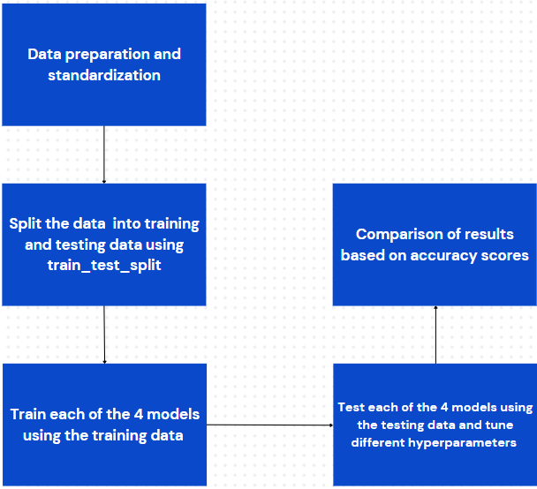
Predictive Analysis (Classification)
Hyper-parameters were evaluated using GridSearchCV() and the best was selected using ‘.best_params
Using the best hyper-parameters, each of the four models were scored on accuracy by using the testing data set.
Add the GitHub URL of your completed predictive analysis lab, as an external reference and peer-review purpose

Slide 16
Results
Exploratory data analysis results
Interactive analytics demo in screenshots
Predictive analysis results

Slide 17

Section 2

Slide 18
Flight Number vs. Launch Site
Show a scatter plot of Flight Number vs. Launch Site
Show the screenshot of the scatter plot with explanations
CCAFS SLC 40 is currently the most successful launch site, with VAFB SLC 4E and KSCLC 39A following. The overall success rate has improved over time. While a higher payload mass at CCAFS SLC 40 is generally associated with a better success rate, the visualization does not clearly establish a direct link between launch site success and payload mass.

Slide 19
Payload vs. Launch Site
Show a scatter plot of Payload vs. Launch Site
Show the screenshot of the scatter plot with explanations
The greater the payload mass for launch site CCAFS SLC 40 the higher the success rate for the rocket.

Slide 20
Success Rate vs. Orbit Type
Show a bar chart for the success rate of each orbit type
Show the screenshot of the scatter plot with explanations
The orbit types ES-L1, GEO, HEO, and SSO have the highest success rates, but it's important to consider the number of launches per orbit type when interpreting these results.

Slide 21
Flight Number vs. Orbit Type
Show a scatter point of Flight number vs. Orbit type
Show the screenshot of the scatter plot with explanations
In LEO orbits, success is linked to the number of flights, while in GTO orbits, there is no clear relationship between flight number and success.

Slide 22
Payload vs. Orbit Type
Show a scatter point of payload vs. orbit type
Show the screenshot of the scatter plot with explanations
• Some orbit types have better success rates than
others.
Success rate appears to
have no obvious correlation
with payload mass.

Slide 23
Launch Success Yearly Trend
Show a line chart of yearly average success rate
Show the screenshot of the scatter plot with explanations
Based on the plot , we can observe that success rate has increased since 2013 and kept on increasing till 2020

Slide 24
All Launch Site Names
Find the names of the unique launch sites (scrrenshot)
Query: SELECT DISTINCT LAUNCH_SITE FROM SPACEXDATASET;
• Result:
• Explanation As its showen in the result there are 4 unique launch sites

Slide 25
Launch Site Names Begin with 'CCA'
Find 5 records where launch sites begin with `CCA`
Present your query result with a short explanation here
• Query: SELECT * FROM SPACEXDATASET WHERE launch_site LIKE 'CCA%' LIMIT 5;
• Result:
• Explanation: This is a fairly straightforward sampling mechanism used to gain a sense of the data contained in the database table.

Slide 26
Total Payload Mass
Calculate the total payload carried by boosters from NASA
Present your query result with a short explanation here
• Query: SELECT sum(payload_mass__kg_) AS "Total Payload Mass (kg)" FROM SPACEXDATASET WHERE customer LIKE '%NASA (CRS)%';
• Result:
• Explanation: The total payload carried by boosters from NASA is 48,213 kg.

Slide 27
Average Payload Mass by F9 v1.1
Calculate the average payload mass carried by booster version F9 v1.1
Present your query result with a short explanation here
• Query: SELECT sum(payload_mass__kg_) / count(payload_mass__kg_) AS “Average Payload Mass (kg)" FROM SPACEXDATASET WHERE booster_version LIKE 'F9 v1.1';
• Result:
• Explanation: The average payload mass carried by booster version F9 v1.1 is 2,928 kg.

Slide 28
First Successful Ground Landing Date
Find the dates of the first successful landing outcome on ground pad
Present your query result with a short explanation here
Query: SELECT min(DATE) AS "First Successful Landing Outcome Date" FROM SPACEXDATASET WHERE landing__outcome LIKE ‘Success (ground pad)’;
• Result:
• Explanation: The first successful landing outcome on ground pad occurred on December 22, 2015.

Slide 29
Successful Drone Ship Landing with Payload between 4000 and 6000
List the names of boosters which have successfully landed on drone ship and had payload mass greater than 4000 but less than 6000
Present your query result with a short explanation here
• Query: SELECT DISTINCT booster_version FROM SPACEXDATASET WHERE landing__outcome = 'Success (drone ship)' and payload_mass__kg_ BETWEEN 4000 and 6000;
• Result:
• Explanation: The four booster versions that have successfully landed on drone ship with a payload mass greater than 4,000 kg but less than 6,000 kg are listed above.

Slide 30
Total Number of Successful and Failure Mission Outcomes
Calculate the total number of successful and failure mission outcomes
Present your query result with a short explanation here
• Query: SELECT (SELECT count(*) FROM SPACEXDATASET WHERE lcase(landing__outcome) LIKE '%success%') AS "Success“, count(*) AS "Failure" FROM SPACEXDATASET WHERE lcase(landing__outcome) NOT LIKE '%success%’;
• Result:
• Explanation: There were 61 successful and 40 failed mission outcomes.

Slide 31
Boosters Carried Maximum Payload
List the names of the booster which have carried the maximum payload mass
Present your query result with a short explanation here
• Query: SELECT booster_version, payload_mass__kg_ FROM SPACEXDATASET WHERE payload_mass__kg_ = (SELECT max(payload_mass__kg_) FROM SPACEXDATASET);
• Result:
• Explanation: The maximum payload mass carried in this dataset is 15,600 kg. Twelve (12) separate Falcon 9 boosters carried this amount of payload mass.

Slide 32
2015 Launch Records
List the failed landing_outcomes in drone ship, their booster versions, and launch site names for in year 2015
Present your query result with a short explanation here
Query: SELECT MONTHNAME(DATE) AS “Month”, landing__outcome, booster_version, launch_site FROM SPACEXDATASET WHERE landing__outcome = 'Failure (drone ship)' AND YEAR(DATE) = 2015;
• Result:
• Explanation: There were two failed landing outcomes with a drone ship in 2015. Both launched from CCAFS LC-40. One occurred in January and the other in April.

Slide 33
Rank Landing Outcomes Between 2010-06-04 and 2017-03-20
Rank the count of landing outcomes (such as Failure (drone ship) or Success (ground pad)) between the date 2010-06-04 and 2017-03-20, in descending order
Present your query result with a short explanation here
• Query: SELECT landing__outcome, count(landing__outcome) AS "Count" FROM SPACEXDATASET WHERE DATE BETWEEN '2010-06-04' AND '2017-03-20' GROUP BY landing__outcome ORDER BY count(landing__outcome) DESC;
• Result:
• Explanation: The most common landing outcome was ‘not attempted’.

Slide 34

Section 3

Slide 35
<Folium Map Screenshot 1>
Replace <Folium map screenshot 1> title with an appropriate title
Explore the generated folium map and make a proper screenshot to include all launch sites’ location markers on a global map
Explain the important elements and findings on the screenshot

Slide 36
<Folium Map Screenshot 2>
Replace <Folium map screenshot 2> title with an appropriate title
Explore the folium map and make a proper screenshot to show the color-labeled launch outcomes on the map
Explain the important elements and findings on the screenshot

Slide 37
<Folium Map Screenshot 3>
Replace <Folium map screenshot 3> title with an appropriate title
Explore the generated folium map and show the screenshot of a selected launch site to its proximities such as railway, highway, coastline, with distance calculated and displayed
Explain the important elements and findings on the screenshot

Slide 38

Section 4

Slide 39
Total success launches by all sites
Show the screenshot of launch success count for all sites, in a piechart
KSC LC-39A recorded the most successful launches among all sites.

Slide 40
Success rate by site
Show the screenshot of the piechart for the launch site with highest launch success ratio
KSC LC-39A had a 76.9% success rate and a 23.1% failure rate.

Slide 41
Payload vs. Launch Outcome
Show screenshots of Payload vs. Launch Outcome scatter plot for all sites, with different payload selected in the range slider
Success rates are higher for low-weight payloads compared to heavy ones.

Slide 42

Section 5

Slide 43
Classification Accuracy
Visualize the built model accuracy for all built classification models, in a bar chart
Find which model has the highest classification accuracy

Slide 44
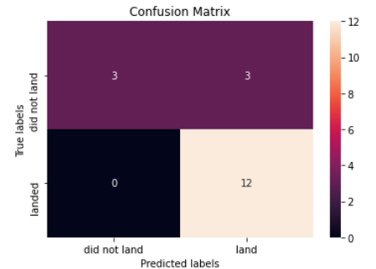
Confusion Matrix
The confusion matrix for the Decision Tree Classifier demonstrates its accuracy, with a high number of true positives and true negatives indicating effective classification. However, the classifier's primary challenge is the occurrence of false positives, where unsuccessful landings are incorrectly identified as successful
Prediction Breakdown:
• 12 True Positives and 3 True Negatives
• 3 False Positives and 0 False Negatives

Slide 45
Conclusions
Success Trends: SpaceX’s Falcon 9 first stage landing outcomes have improved over time, with success rates increasing notably from 2013 to 2020. KSC LC-39A emerged as the most successful launch site, and orbits such as ES-L1, GEO, HEO, SSO, and VLEO showed high success rates.
Payload Insights: Launches with payloads over 7,000 kg tend to be less risky, indicating that heavier payloads are associated with better outcomes.
Predictive Modeling: The Decision Tree Classifier is effective for predicting successful landings, offering a valuable tool for optimizing future missions and enhancing profitability.

Slide 46
Appendix
For notebook and datasets , check this Github repository link :
link

Slide 47


